Slide 1
Digital Payment Trends & User Behavior Analysis

Slide 2
Objective
- Analyze growth trends in digital transactions over time
- Understand user behavior and transaction patterns
- Identify regional variations in digital adoption
- Evaluate factors influencing transaction volume and engagement

Slide 3
Dataset Overview
- Multi-source dataset including:
• State-level transactions
• District-level data
• Device usage statistics
• Demographic information
- Key variables analyzed:
• Transaction count & amount
• Registered users & app opens
• Population density

Slide 4
Methodology
- Data preprocessing and cleaning for consistency
- Aggregation and grouping for trend analysis
- Exploratory Data Analysis (EDA) to identify patterns
- Correlation analysis to study influencing factors
- Visualization using line, bar, and pie charts

Slide 5
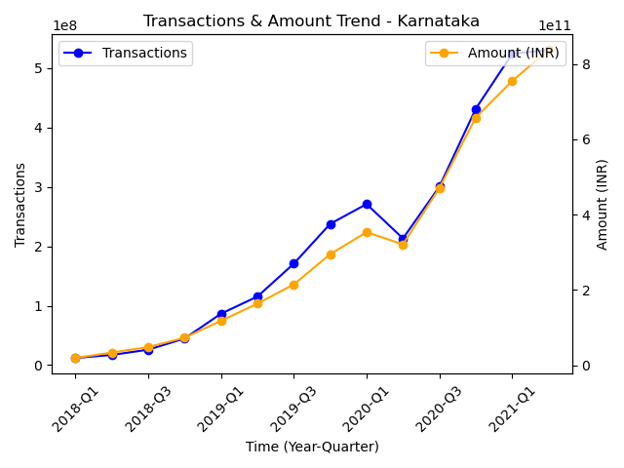
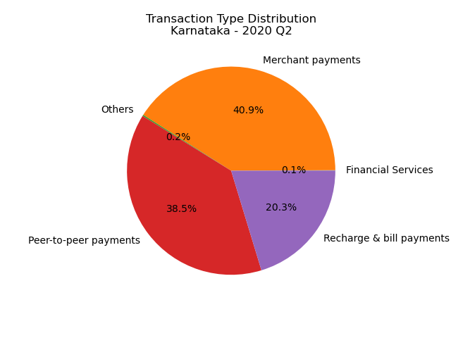
Key Visual Insights 📊
Trend shows increasing adoption Distribution shows dominant usage types
- Transaction volume and value show a strong upward trend
- Growth accelerates over time, indicating increasing user engagement
- Merchant and P2P transactions dominate everyday usage

Slide 6
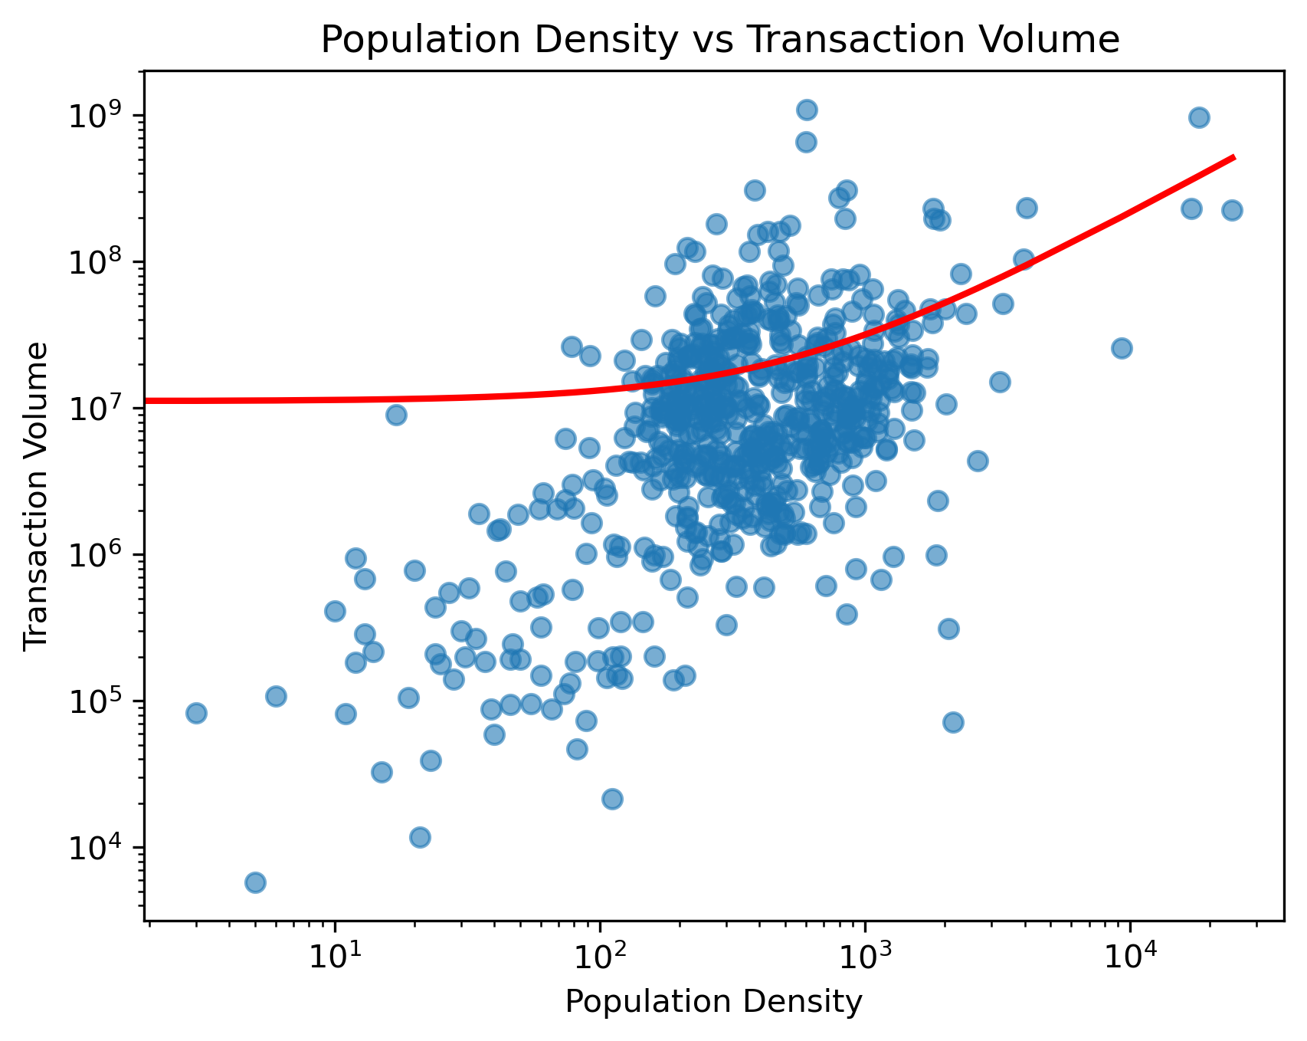
Advanced Analysis 🔥
-
- Population density shows a moderate positive relationship with transaction volume
- High-density regions generate more transactions, but variation exists due to infrastructure and awareness
- Device usage is concentrated among a few brands, indicating mass adoption
- Increasing app opens reflect rising user engagement

Slide 7
Key Insights & Business Implications⭐
- Digital transactions are growing rapidly, indicating strong adoption of digital payment systems
- Merchant and peer-to-peer payments dominate, showing widespread use in daily transactions
- Significant regional variations highlight differences in infrastructure and digital maturity
- Population density influences transaction volume, but is not the sole driver
- Increasing app usage reflects rising user engagement and dependency on digital platforms
Digital payment adoption is driven by a combination of population, infrastructure, and user awareness—not population alone

Slide 8
Conclusion & Recommendations 🚀
Conclusion:
- Digital payment adoption is growing rapidly across regions
- Transaction volume and user engagement have increased consistently over time
- Regional differences highlight opportunities for targeted improvement
Recommendations:
- Improve digital infrastructure in low-performing regions
- Increase awareness and digital literacy among users
- Promote merchant adoption to expand everyday usage
- Optimize applications for mid-range devices to reach a wider audience

